Slide 1
RESULT MANAGEMENT SYSTEM
BY
KAUSTUBH DEVKAR (206)
DEPARTMENT OF COMPUTER ENGINEERING
MARATHWADA MITRA MANDAL’S
COLLEGE OF ENGINEERING
PUNE
(2017-18)

Slide 2
INDEX
SR NO. | TITLE
1 | INTRODUCTION
2 | SCOPE
3 | REQUIREMENTS
4 | ER MODEL
5 | GUI SCREENSHOTS
6 | SOURCE CODE
7 | TEST CASES
8 | CONCLUSION

Slide 3
ABSTRACT:
Our project Result Management System can be used by education institutes to maintain & analyse the result records of student easily. Achieving this objective is difficult using a manual system as the information is scattered, can be redundant and collection relevant information may be very time consuming. All these problems are solved using this project.

Slide 4
OBJECTIVES:
To make the tedious work of result analysis and maintenance in college automated with an interactive application which can directly read the result PDF provided by university and parse it into database and generate reports for exam automatically.

Slide 5
SCOPE:
This system is highly efficient and flexible to make easy interactions with the staff. Helpful to perform paperless work and manage all data. It can be used to analyse college academic performance and help college management and staff to create better policies for student.

Slide 6
HARDWARE/SOFTWARE REQUIREMENTS:
OS: Linux / Windows
PROCESSOR: Intel / AMD.
RAM: Minimum 1GB.
STORAGE REQUIREMENT: Minimum 100mb.
SOFTWARE REQUIRED: JDK8, MySQL Database.
Internet Connectivity Required for Email Module.

Slide 7
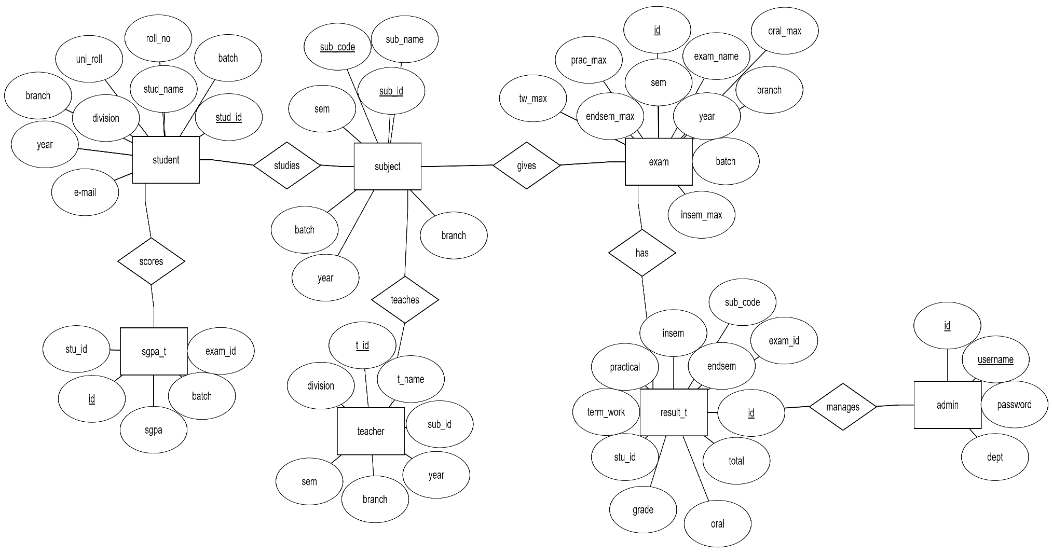
ENTITY RELATIONSHIP DIAGRAM:

Slide 8
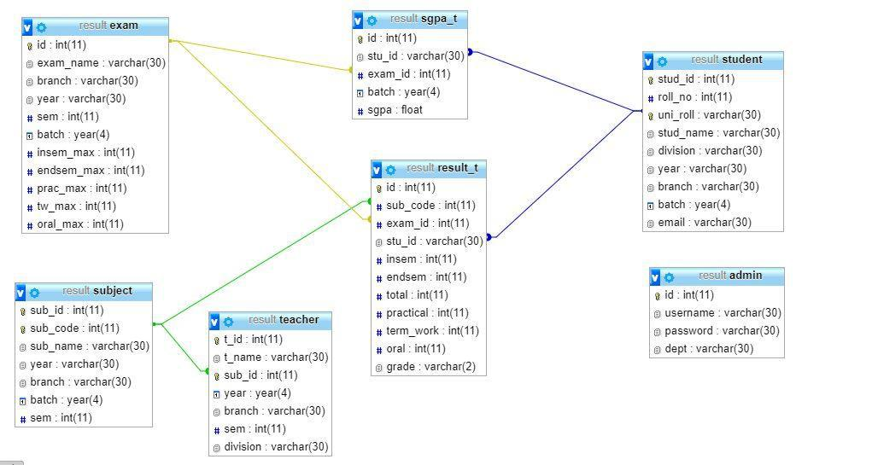
SCHEMA:

Slide 9
DATA FLOW DIAGRAM (DFD):
UNIVERSITY
Sends Result PDF
College
Process Result PDF
Result Management System
Sends Results via Email
Students
Automatically Generate Reports
College Faculty

Slide 10
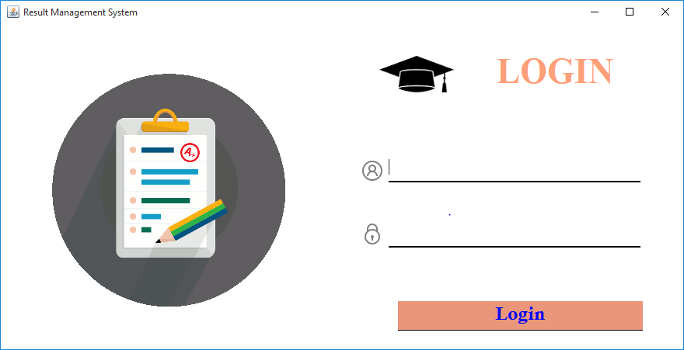
SCREENSHOTS OF UI:

Slide 11
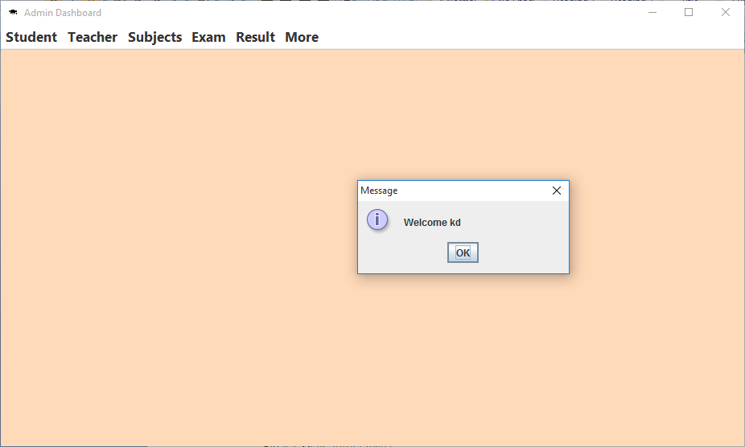

Slide 12
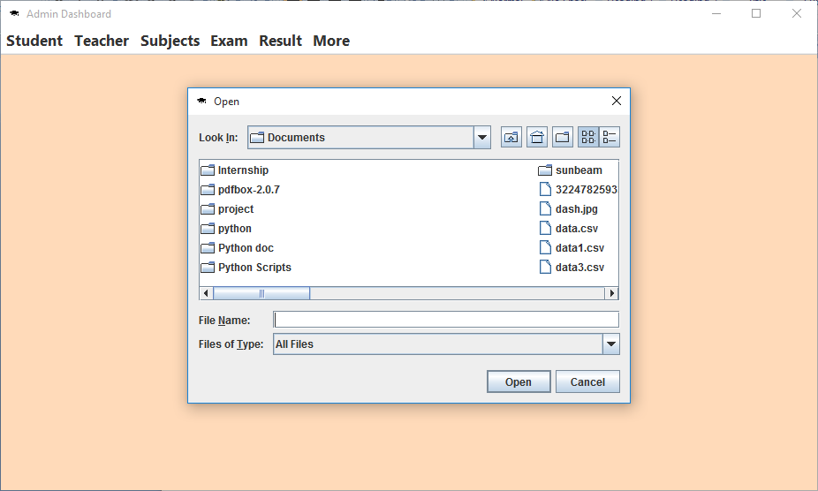

Slide 13
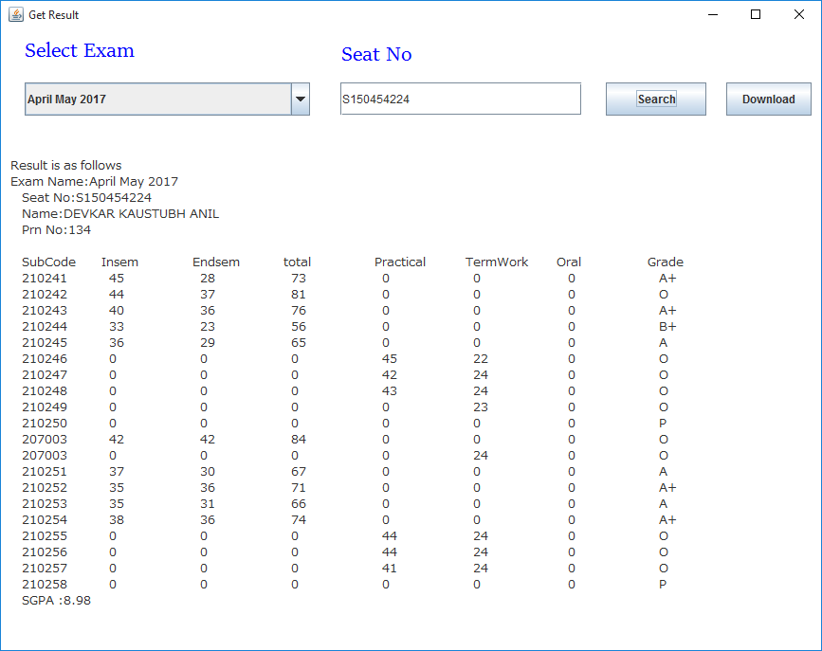

Slide 14
ALGORITHM:
START
Login into the application with correct credentials.
Create exam for which University Result PDF is available.
Import Student Data from .csv file into MySQL Database or add manually all the student Details.
Import Subject Data from .csv file into MySQL Database or add manually all the subject Details.
Add Teacher’s data from .csv file belonging to each Subject or add them manually(optional).
Select exam for which you want to upload Result PDF file
Select Result PDF file provided by University & then it will get parsed into the database.
View individual student result by providing their Seat Number
10. Individual result of student can also be mailed to their respective email ids with their result pdf as an attachment.
11. Generate reports by selecting exam.
12. Logout.
13.END

